Slide 1


Publishing considerations
Anastas Mishev
https://orcid.org/0000-0001-7271-6655

Slide 2
Agenda
Repository
Accompanying files
Fair signposting
Automated publishing workflow

Slide 3
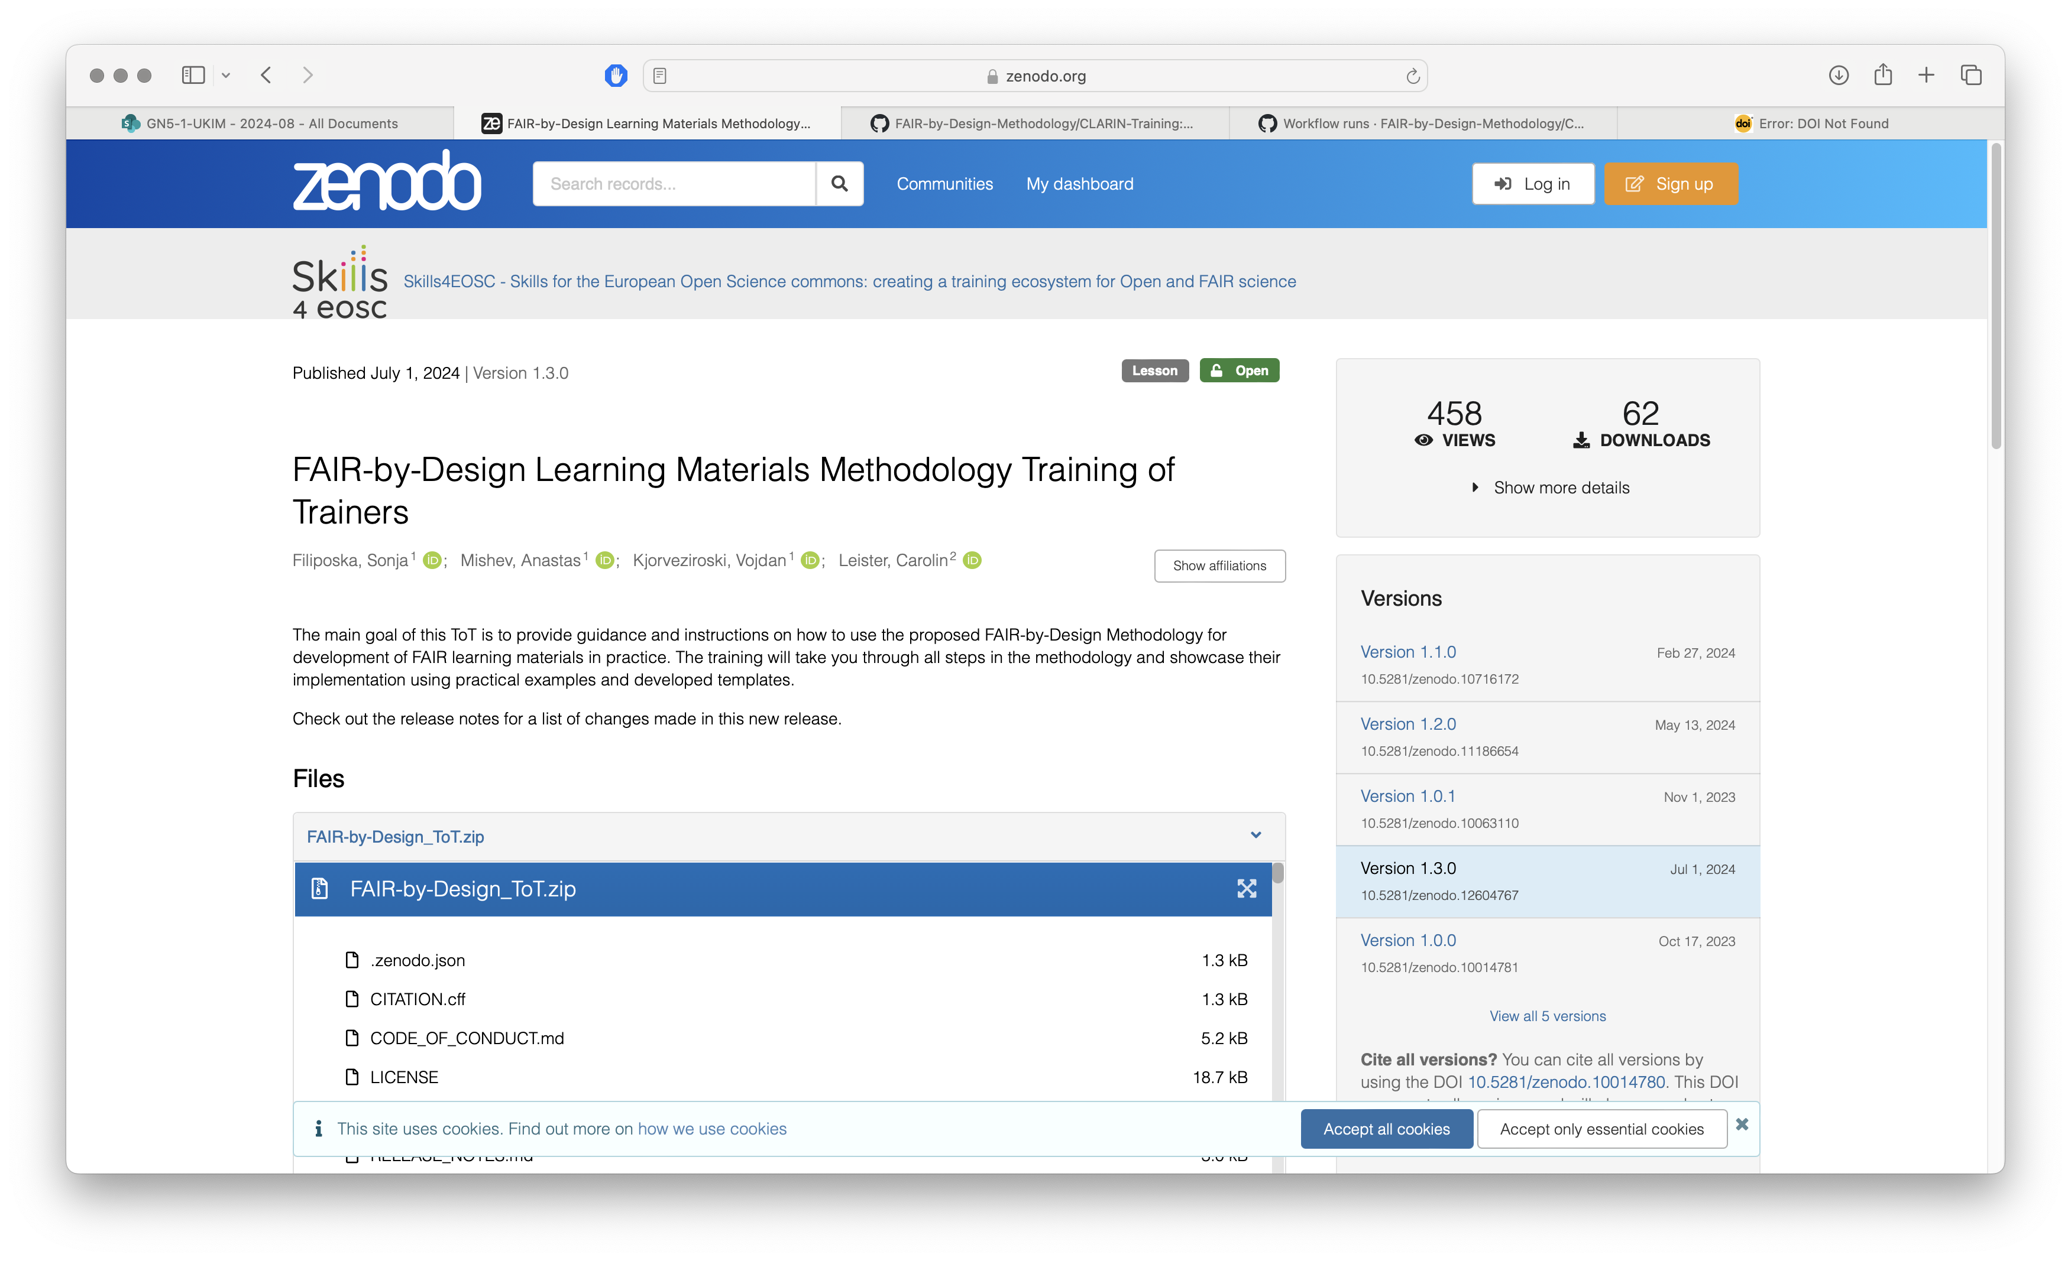
Open Science Repositories

Slide 4
Accompanying files
README.md
briefly describe the repository, so that first time visitors can get an initial idea what it is about.
CODE_OF_CONDUCT.md,
code of conduct which needs to be adhered to, defining the standards for how to engage in a community, resolve problems etc.
Licence.txt
the description of the license under which the training material is released.

Slide 5
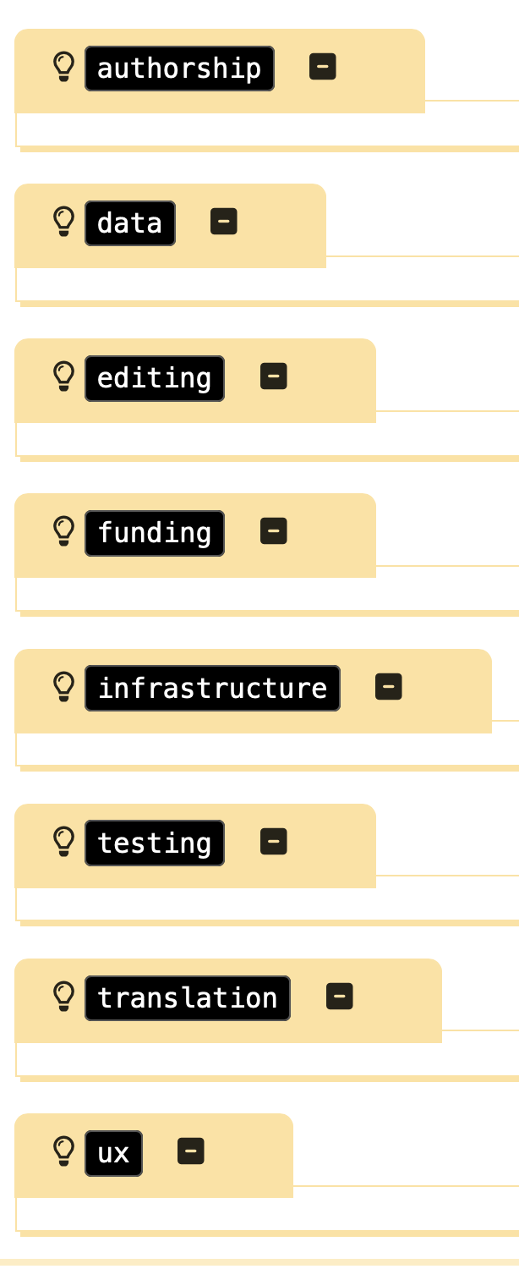
Contributors
No separate file for defining contributors and roles (aside from the RDA metadata fields)
Contributor Role Taxonomy (CRediT) - not standardised, but helpful
All Contributors specification
CONTRIBUTORS file at the top of the repository
Table containing data such as
Name, URL, Category, Link to category definitions
Example schema from Galaxy Training Network.

Slide 6
FAIR Signposting
Lightweight, but powerful approach to increase the FAIRness of learning materials through increased machine readability
Two levels of compliance to FAIR Signposting:
Level 1 provide a minimal set of typed links with the landing page as the link origin.
Level 2 elevates the compliance by providing a comprehensive set of typed links for landing pages, content, and metadata resources.
Not mandatory, but quite useful!

Slide 7
Automated workflow
A set of Git actions that implement the publishing workflow
validation of the information provided in the accompanying files,
implementation of the signposting,
draft entry creation in Zenodo,
updating the DOI in all files that reference it, including slides and syllabus,
rebuilding and
releasing a new version of the Git book.

Slide 8
And the result is:
new or updated entry in the Zenodo repository
updated citation in the Gitpages
updated CITATION.cff file
updated FAIR signposting metadata
updated citation in the PowerPoint slides (if used)
Some fields should be edited manually, while others are automatically updated by the publishing workflow and should not be manually changed. Examples of such field are version, doi, date-released from the CITATION.cff.

Slide 9
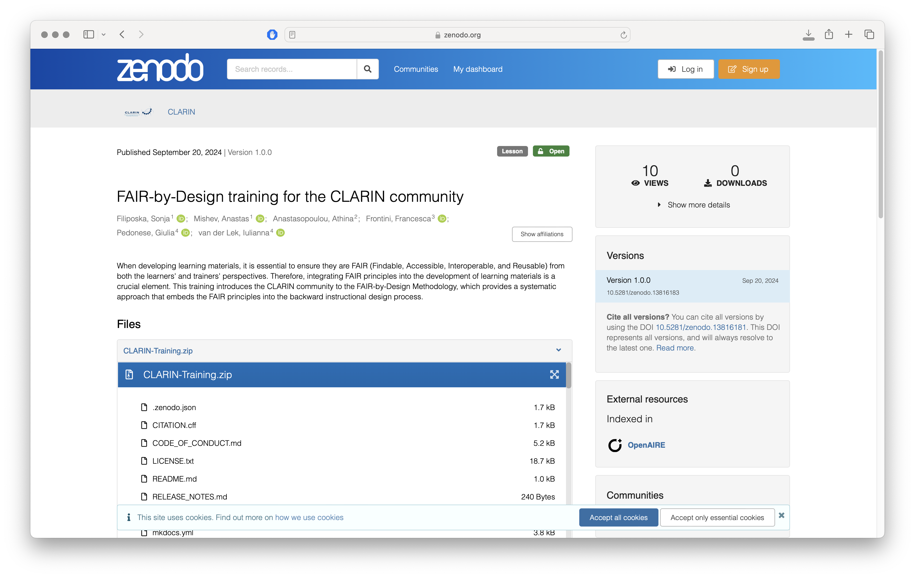

Slide 10
FAIR Signposting:
Has two levels of compliance
Is intended to be read by humans
It uses the post method to sign the pages
Is used to enable better machine understanding of the materials

Slide 11
Summary
Choice of repository
Accompanying files
FAIR Signposting
Automated workflow

Slide 12
Thank you! Any questions?
sonja.filiposka@finki.ukim.mk

